Slide 1

Amit Srivastava

Slide 2
What is AngularJS
Open Source Client Side JavaScript Framework created by Google
It is not Library like Jquery , Rather a Framework to build well Architected Web Applications.
It is Client Side with MVC/MVVM/MVW capability.
It Enhances HTML by adding directives, custom tags, expressions and templates with HTML.

Slide 3
Why AngularJS
Collect Input from the User
Update Display
Communicate with the Server
Event Binding and DOM Manipulation
Multi Browser Support

Slide 4
HTML and JavaScript
Traditional Models: 70% JavaScript & 30% HTML
Jquery: 50% JavaScript & 50% HTML
ExtJS : 99% Javascript
Angular JS: 30% Javascript & 70%HTML

Slide 5
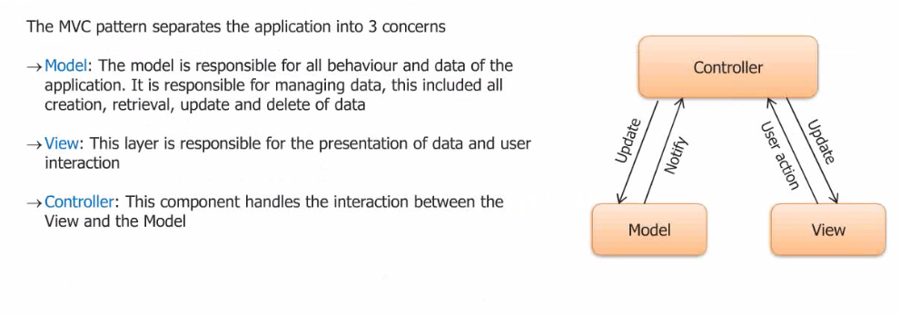
MVC

Slide 6
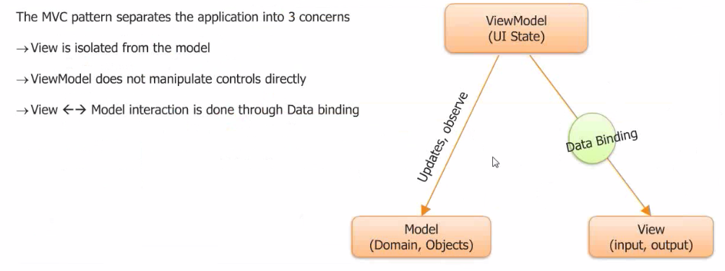
MVVM

Slide 7
Confusing Stuff
?
Transclusion
Restriction
Scope
Directive
Linking

Slide 8

Data Binding
MVC
Routing
Testing
jqLite
Templates
History
Factories
ngularJS is a full-featured SPA framework
ViewModel
Controllers
Views
Directives
Controllers
Dependency Injection
Validation
Notes:
Demo

Slide 9
Modules
Module is a container for different parts app – controllers, services, filters, directives, etc
angular.module(name, [requires], [configFn])
Package code as reusable modules.
Unit tests only have to load relevant modules
The modules can be loaded in any order (or even in parallel)
Easier to understand code and maintain.
Notes:
Configuration blocks - get executed during the provider registrations and configuration phase. Only providers and constants can be injected into configuration blocks. This is to prevent accidental instantiation of services before they have been fully configured.
Run blocks - get executed after the injector is created and are used to kickstart the application. Only instances and constants can be injected into run blocks. This is to prevent further system configuration during application run time.

Slide 10
Scopes
Scopes serve as the GLUE b/w Controller & View
When Angular starts to run and generate the view, it will create a binding from the root ng-app element to the $rootScope
This $rootScope is the eventual parent of all $scope objects
Controller
View
MODEL

Slide 11
Live Update of View
MAGIC?

Slide 12
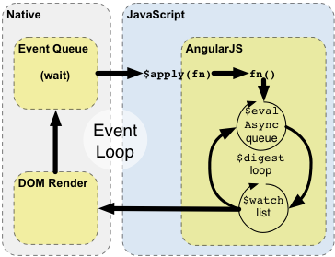
Angular Digest Loop
Notes:
$compile - it can take the whole markup and turn it linking function that, when executed against a certain scope will turn a piece of HTML text into dynamic, live DOM with all the directives (here: ng-src) reacting to model changes. One would invoke it as follows: $compile(imgHtml)($scope) and would get DOM element with all the DOM event bounds as a result. $compile is making us of $interoplate (among other things) to do its job.
$interpolate knows how to process a string with embedded interpolation expressions, ex.: /path/{{name}}.{{extension}}. In other words it can take a string with interpolation expressions, a scope and turn it into the resulting text. One can think of the $interpolationservice as of very simple, string-based template language. Given the above example one would use this service like: $interpolate("/path/{{name}}.{{extension}}")($scope) to get the path/image.jpg string as a result.
$parse is used by $interpolate to evaluate individual expressions (name, extension) against a scope. It can be used to both read and set values for a give expression. For example, to evaluate the name expression one would do: $parse('name')($scope) to get the "image" value. To set the value one would do: `$parse('name').assign($scope, 'image2')
$parse is concerned with individual expressions only (name, extension). It is read-write service.
$interpolate is read only and is concerned with string containing multiple expressions (/path/{{name}}.{{extension}})
$compile is at the hart of AngularJS machinery and can turn HTML strings (with directives and interpolation expressions) into live DOM.

Slide 13
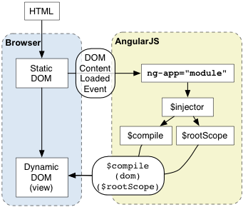
Angular Initialization

Slide 14
Modules
Module
Config
Routes
View
$scope
Controller
Directives
*Factory

Slide 15
Service vs Factories vs Providers
Services
Syntax: module.service( 'serviceName', function ); Result: When declaring serviceName as an injectable argument you will be provided with an instance of the function. In other words new FunctionYouPassedToService().
Factories
Syntax: module.factory( 'factoryName', function ); Result: When declaring factoryName as an injectable argument : the value that is returned by invoking the function reference passed to module.factory.
Providers
Syntax: module.provider( 'providerName', function ); Result: When declaring providerName as an injectable argument : ProviderFunction().$get().
Notes:
Providers have the advantage that they can be configured during the module configuration phase.

Slide 16
Single Page Application - SPA
SPA Demo
http://www.myspa.com
View
View
View
View

Slide 17
Building Applications Fast
"A Toolman is known by the tools he keeps“
Maven
Build Tool: Create Archives & Deploy on Server
Dependency Management
Scaffling - Initial Structure – archetype
Support for Repositories

Slide 18
Tools for Angular
• NodeJS
• Grunt – Build & Deploy
• Bower – Dependency Management
• Yeoman - Scaffling
• Karma
• Protractor

Slide 19
Steps for installation
npm install -g yo
$ yo --version && bower --version && grunt –version
npm install -g generator-webapp/generator-angular
Check on path env: node_modules location
Bower.
Bower install angular-bootstrap (requires git)
After installing git, put it on path
Yo webapp/angular
Grunt build
Grunt serve

Slide 20
Angular JS Comparison
Feature | Angular | Backbone | CanJS | Ember
Observables | y | y | y | y
Routing | y | y | y | y
View bindings | y |  | y | y
Two way bindings | y | – | – | y
Partial views | y | – | y | y
Filtered list views | y | – | y | y

Slide 21
Scores
 | Angular | Backbone | CanJS | Ember
Features | 5 | 2 | 4 | 5
Flexibility | 3 | 5 | 4 | 3
Learning curve | 2 | 4 | 5 | 3
Developer productivity | 4 | 2 | 4 | 5
Community | 4 | 5 | 3 | 4
Ecosystem | 4 | 5 | 2 | 4
Size | 4 | 5 | 5 | 2
Performance | 3 | 4 | 5 | 4
Maturity | 4 | 5 | 4 | 3
Memory leak safety | 5 | 3 | 5 | 5
Testability | 5 | 4 | 4 | 4
 | 43 | 44 | 45 | 42
Notes:
Angular & Ember: Do things framework way
Learning Curve: Lack of examples
Angular is slow in comparison boz of digest loop

